Slide 1

Angular + NgRx Exploring the Essentials of NgRx!
Eric Greene, Programmer/Instructor

Slide 2



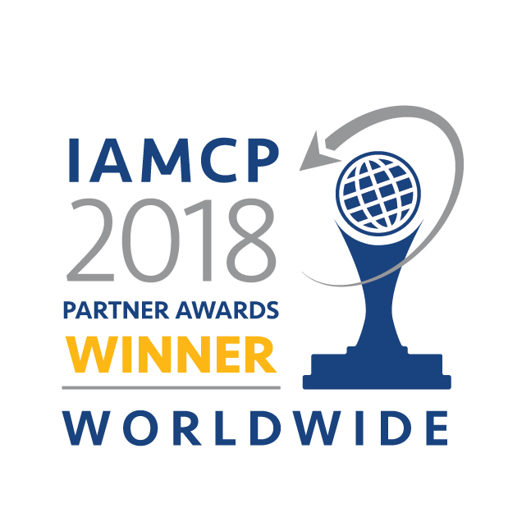
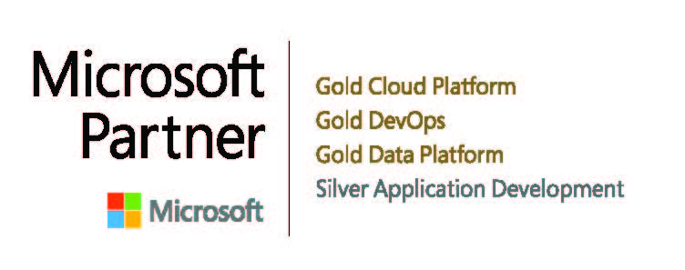
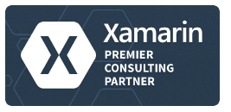
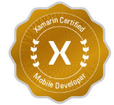

Wintellect’s Core Services
Consulting
Custom software application development and architecture
Instructor-led Training
Microsoft’s #1 training vendor for over 15 years having trained more than 50,000 Microsoft developers
On-Demand Training
World class, subscription based online training

Slide 3
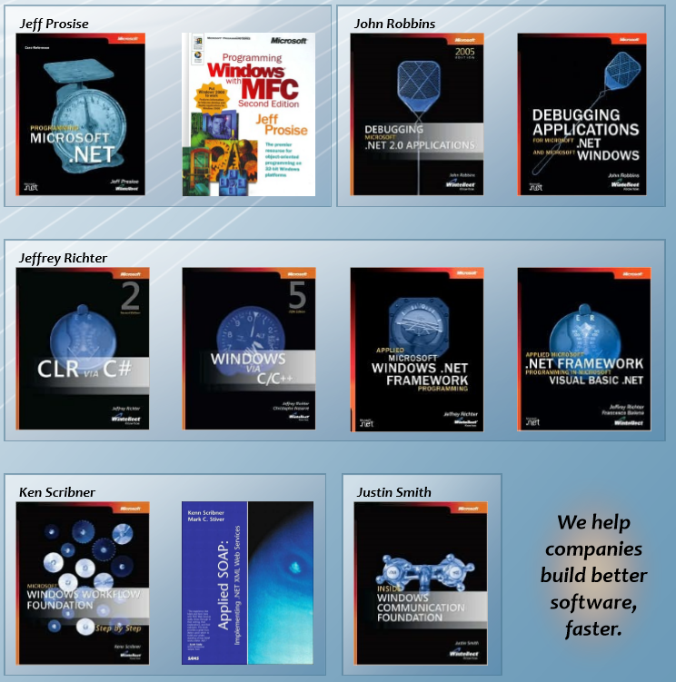
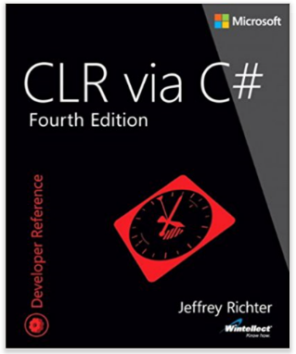
Industry Influencers We wrote the book (over 30 of them)

Slide 4



Special offer for attendees of this webinar
10% discount on any public virtual MOC courses
www.wintellect.com/moc
10% discount on Microsoft Certification Roles Training
AppDev / Cloud FREE Briefing or Q&A
Discuss your project or topic of interest!
Get a 1 on 1 briefing or lunch & learn.
Azure cloud, DevOps, Data & AI, Modern Web development, and more!
10% discount for private onsite training
For more details, contact Martha Garron at mgarron@wintellect.com
Notes:
“I wont’ address this slide for now, but for those in the audience that stay to the end, we’ll have some free services and discounts that you can take advantage of if interested. I’ll show this again at the end of the Webinar.”

Slide 5
Webinar Agenda
NgRx Basics!
Actions, Reducers, Selectors
Redux Developer Tools
REST API calls with Effects
Connect Angular Router to NgRx

Slide 6
Angular with NgRx
Angular is a popular JavaScript-based user interface (UI) framework
NgRx is an application state management library for Angular which uses the principles of Redux and RxJS
NgRx is a great addition to an Angular application, but it can be difficult to learn
Typically, Redux is hard to grasp at first, but once understood, it is fairly easy to work with
The simplest examples of RxJS are pretty easy, but mastery of RxJS is much harder

Slide 7
Angular with NgRx
Source: https://ngrx.io/guide/store

Slide 8
Coding Demos
Let's explore coding examples of these features:
Configuring NgRx
Actions, Reducers, Selectors
Redux DevTools
REST API Calls with Effects
Connecting Routing to NgRx

Slide 9
Special offer for attendees of this webinar
10% discount on any public virtual MOC courses
www.wintellect.com/moc
10% discount on Microsoft Certification Roles Training
AppDev / Cloud FREE Briefing or Q&A
Discuss your project or topic of interest!
Get a 1 on 1 briefing or lunch & learn.
Azure cloud, DevOps, Data & AI, Modern Web development, and more!
10% discount for private onsite training
For more details, contact Martha Garron at mgarron@wintellect.com

Slide 10
Email: wintellectwebinarqa@wintellect.com

